Slide 1

Vision Transformers
Danna Gurari
University of Colorado Boulder Fall 2023
https://home.cs.colorado.edu/~DrG/Courses/RecentAdvancesInComputerVision/AboutCourse.html

Slide 2
Review
Last lecture on semantic segmentation:
Problem
Applications
Datasets
Evaluation metric
Computer vision models: fully convolutional networks
Assignments (Canvas):
Reading assignment was due earlier today
Next reading assignments due on Wednesday and next Monday
Project proposal due on Wednesday
(Student-led lectures start next week)
Questions?

Slide 3
Today’s Topics
Motivation
ViT
Swin Transformer
• Discussion

Slide 4
Today’s Topics
Motivation
ViT
Swin Transformer
• Discussion

Slide 5
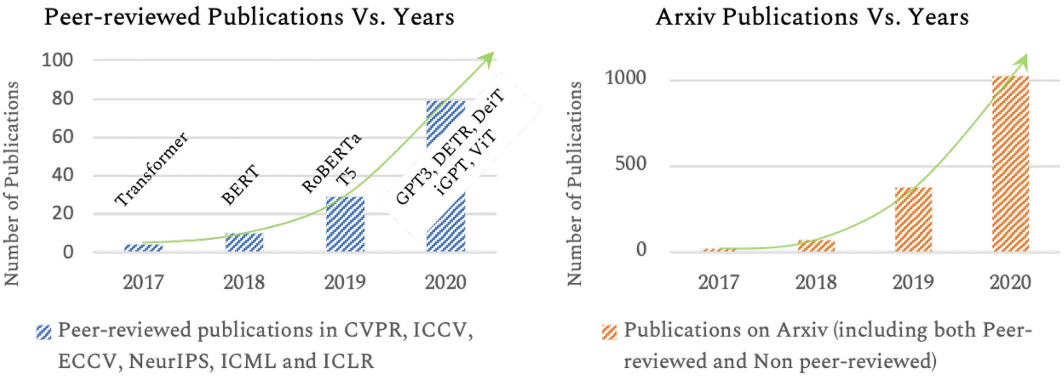
Introduced in 2017, Transformers Achieved Astonishing Performance for NLP Problems
Inspired, researchers in the computer vision community explored transformers for many vision problems and discovered they perform well!
Khan et al. Transformers in Vision: A Survey. CSUR 2022.

Slide 6
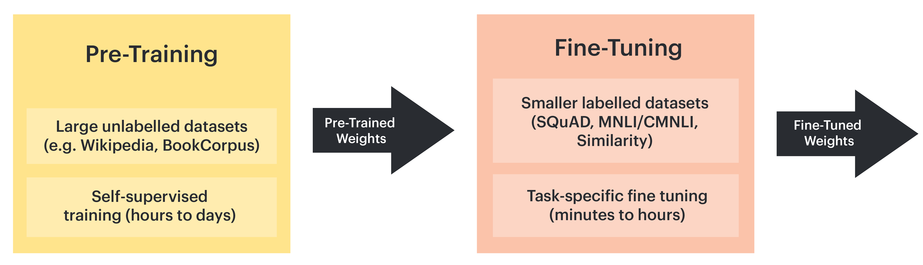
Common Paradigm for NLP Transformers
Inference
Transformers can provide effective features for downstream tasks!
https://docs.graphcore.ai/projects/bert-training/en/latest/bert.html

Slide 7
Today’s Topics
Motivation
ViT
Swin Transformer
Discussion

Slide 8
Why ViT?
Named after the proposed technique: Vision Transformer
Dosovitskiy et al. An Image is Worth 16x16 Words: Transformers for Image Recognition at Scale. ICLR 2021.

Slide 9
Novelty
First paper to demonstrate that a pure transformer architecture can achieve strong performance on vision tasks, achieving comparable or better image classification results to the best methods at the time

Slide 10
Approach
Inference
https://docs.graphcore.ai/projects/bert-training/en/latest/bert.html

Slide 11
ViT: Key Ingredients for Success
Transformer architecture (embeds self-attention)
Pre-training with massive amounts of data

Slide 12
ViT: Key Ingredients for Success
Transformer architecture (embeds self-attention)
Pre-training with massive amounts of data

Slide 13
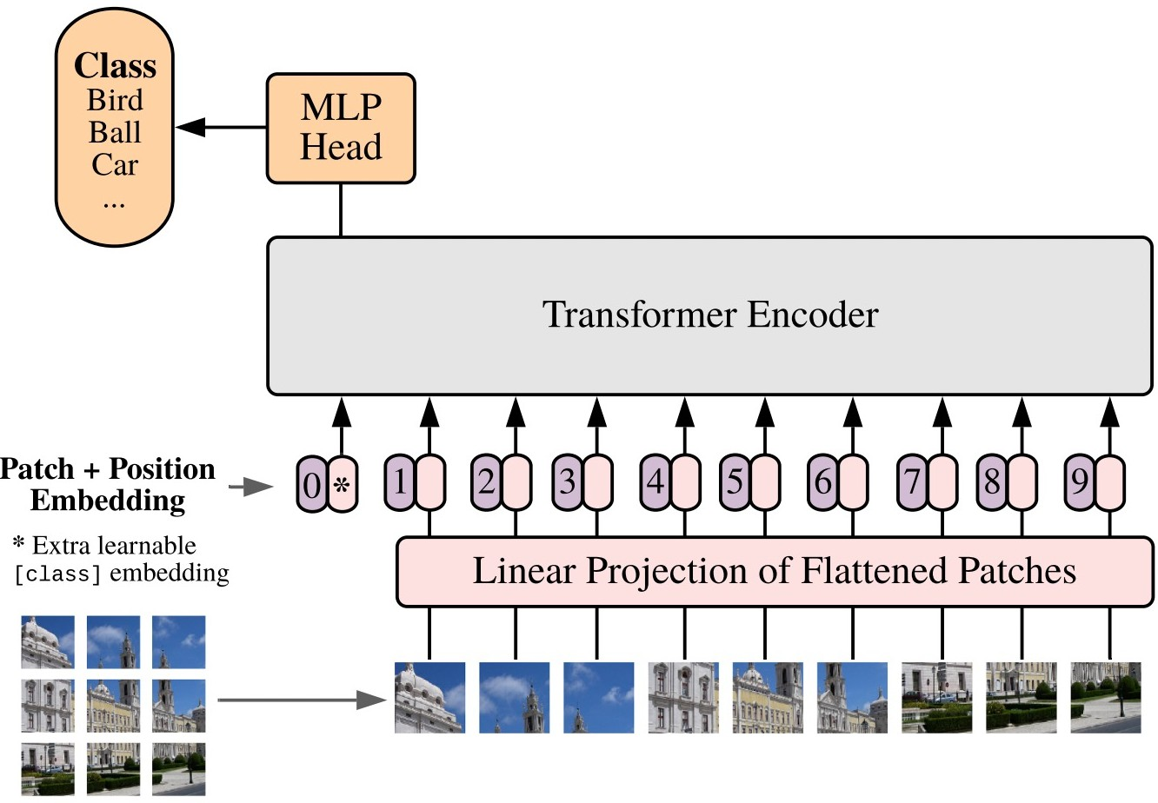
Architecture
Dosovitskiy et al. An Image is Worth 16x16 Words: Transformers for Image Recognition at Scale. ICLR 2021.

Slide 14
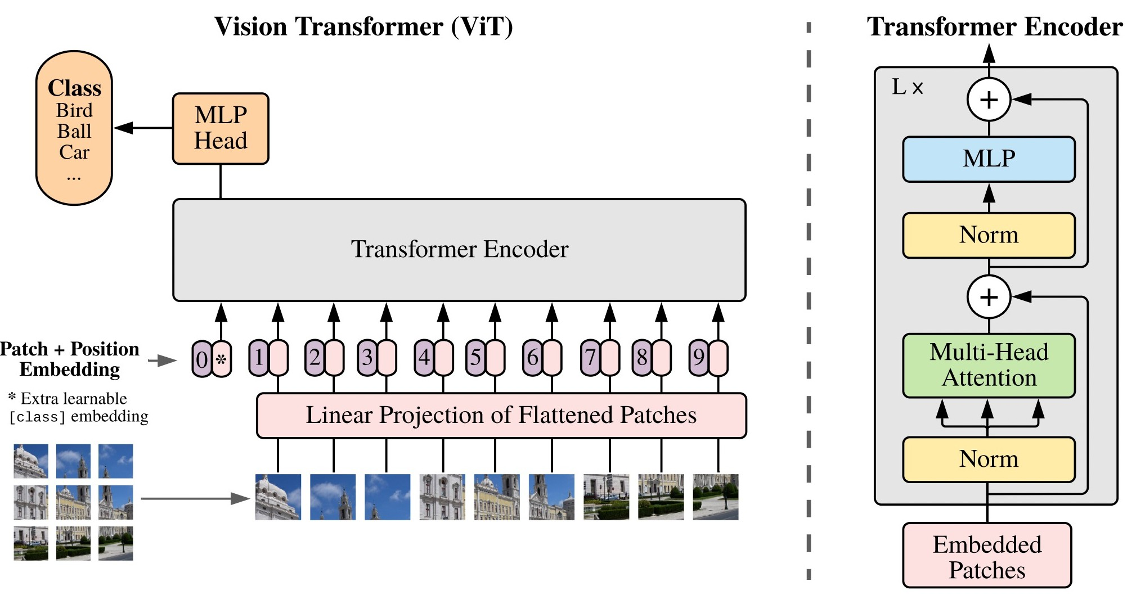
Architecture: Uses Popular BERT Architecture
Dosovitskiy et al. An Image is Worth 16x16 Words: Transformers for Image Recognition at Scale. ICLR 2021.

Slide 15
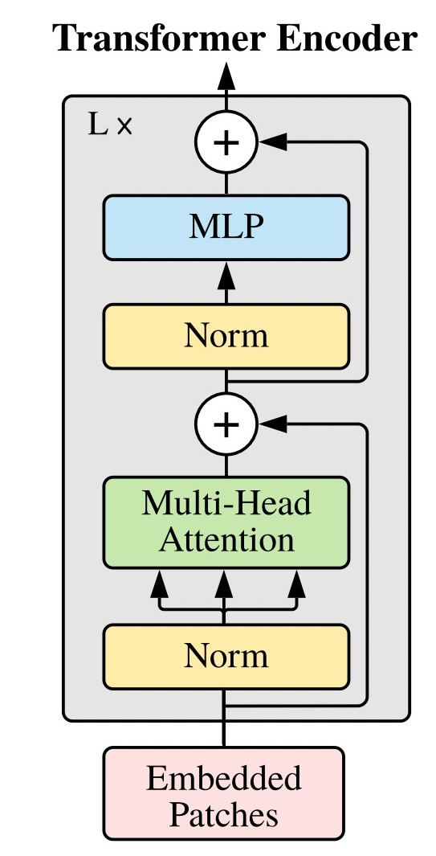
Architecture: Key Novelty is Self-Attention
Dosovitskiy et al. An Image is Worth 16x16 Words: Transformers for Image Recognition at Scale. ICLR 2021.

Slide 16
Self-Attention: Idea
New representation of each pixel showing its relationship to all pixels; e.g., assume this 3x3 image

Slide 17


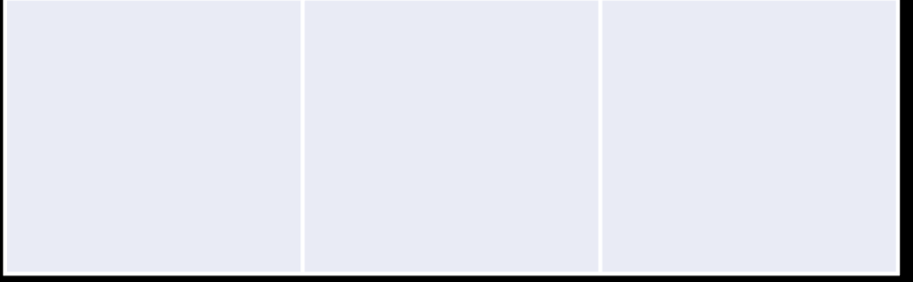
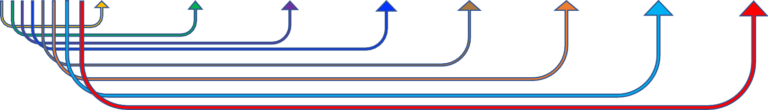
Self-Attention: Idea
New representation of each pixel showing its relationship to all pixels; e.g., assume this 3x3 image
Learned new representation indicates which global information clarifies a pixel’s meaning (e.g., include in the representation of a pixel of an eye context of what animal it belongs to)

Slide 18
Self-Attention: Idea
New representation of each pixel showing its relationship to all pixels; e.g., assume this 3x3 image
Learned new representation indicates which global information clarifies a pixel’s meaning (e.g., include in the representation of a pixel of an eye context of what animal it belongs to)

Slide 19
Self-Attention: Idea
New representation of each pixel showing its relationship to all pixels; e.g., assume this 3x3 image

Slide 20
Self-Attention: Idea
New representation of each pixel showing its relationship to all pixels; e.g., assume this 3x3 image
And so on for remaining image pixels…

Slide 21
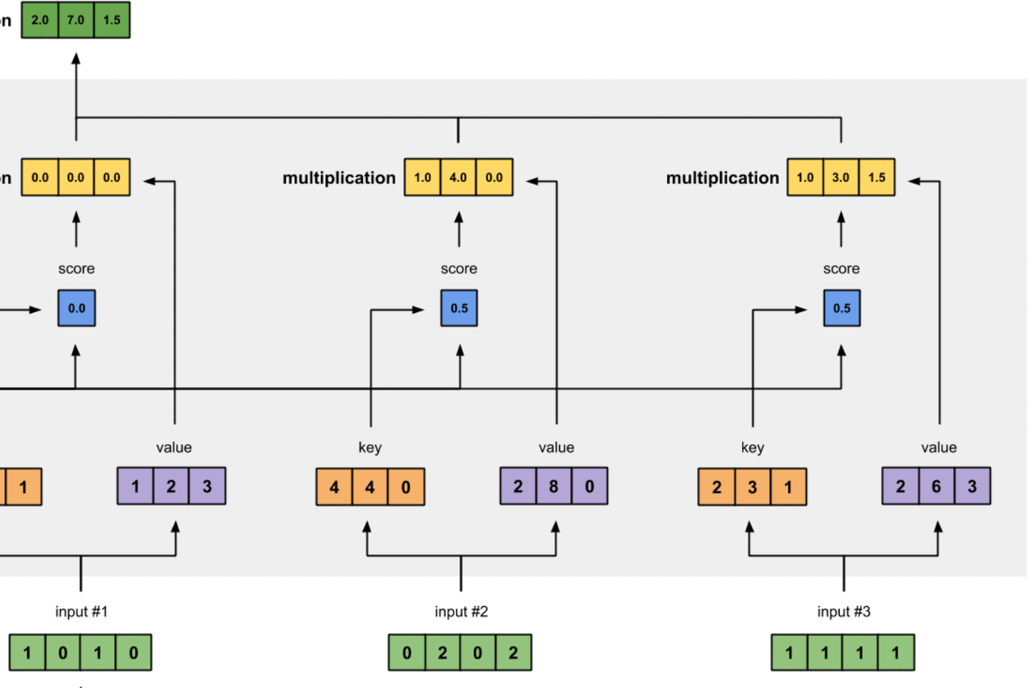
Computing Self-Attention: Example
New representation of each input token to reflect each one’s relationship to all tokens
Weighted sum of values
Input tokens
https://towardsdatascience.com/illustrated-self-attention-2d627e33b20a

Slide 22
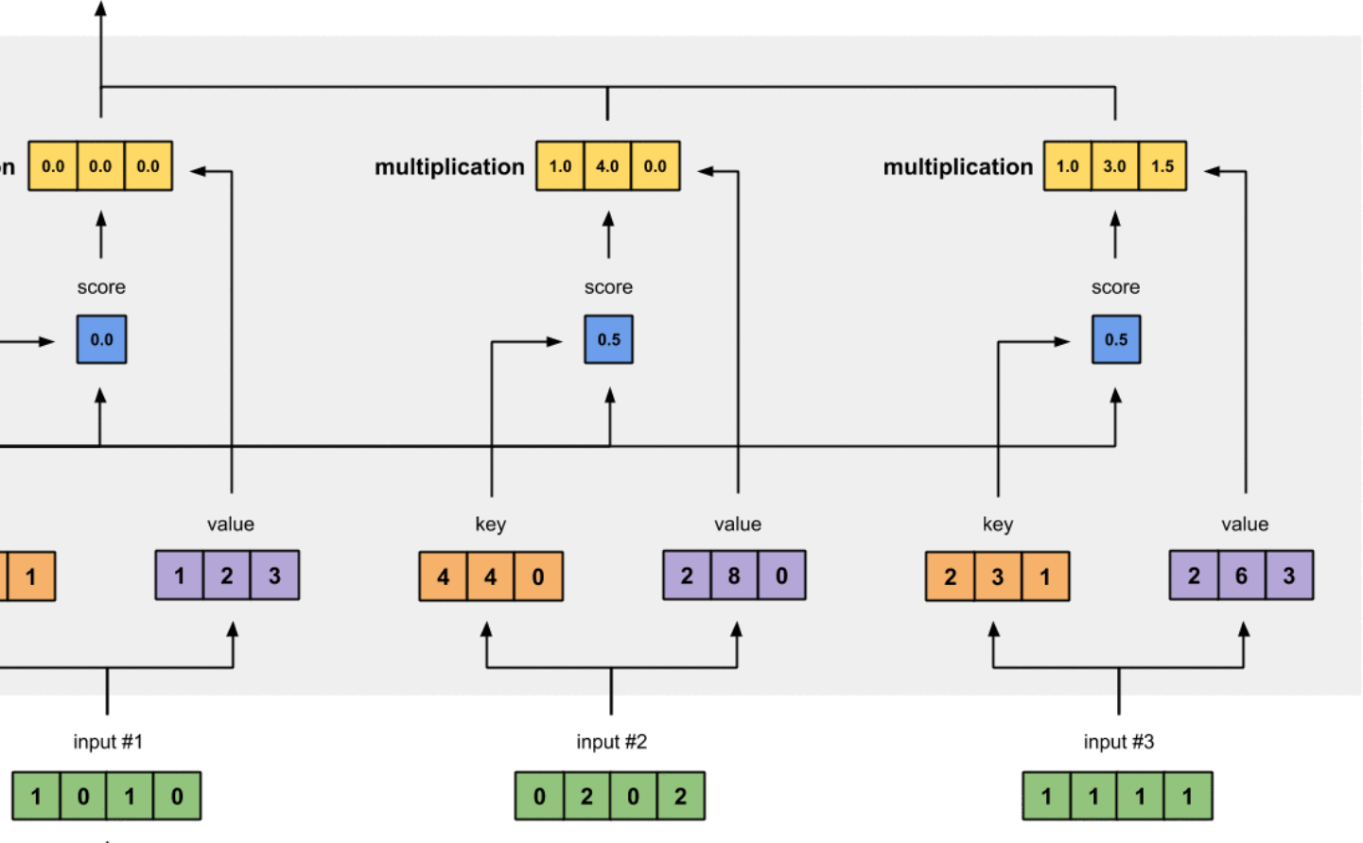
Computing Self-Attention: Example
How many inputs are in this example?
What is each input’s dimensionality?
https://towardsdatascience.com/illustrated-self-attention-2d627e33b20a

Slide 23
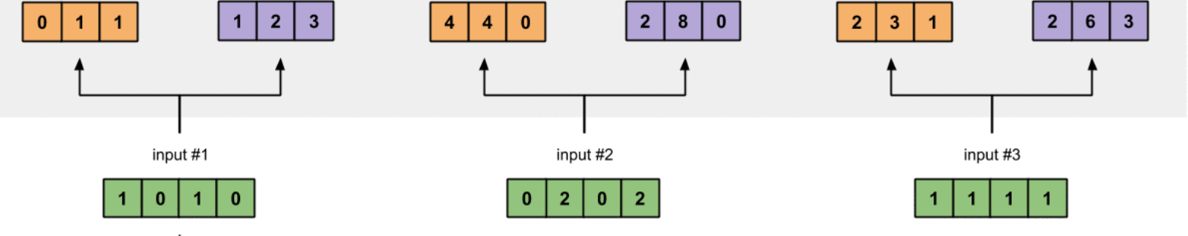

Computing Self-Attention: Example
Key 1:
Value 1:
Key 2:
Value 2:
Key 3:
Value 3:
Three vectors are derived for each input by multiplying with three weight matrices (learned during training): query, key, and value
Query 1:
Query 2:
Query 3:
https://towardsdatascience.com/illustrated-self-attention-2d627e33b20a

Slide 24
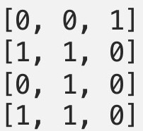
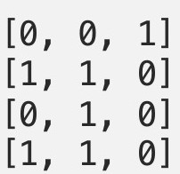
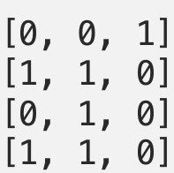
Computing Self-Attention: Example
e.g., key weights
Key 1:
Value 1:
Key 2:
Value 2:
Key 3:
Value 3:
x
x
x
https://towardsdatascience.com/illustrated-self-attention-2d627e33b20a

Slide 25
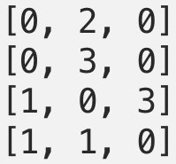
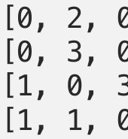
Computing Self-Attention: Example
e.g., value weights
Key 1:
Value 1:
Key 2:
Value 2:
Key 3:
Value 3:
x
x
x
https://towardsdatascience.com/illustrated-self-attention-2d627e33b20a

Slide 26
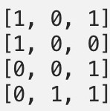
Computing Self-Attention: Example
e.g., query weights
Key 1:
Value 1:
Key 2:
Value 2:
Key 3:
Value 3:
Query 1:
Query 2:
Query 3:
https://towardsdatascience.com/illustrated-self-attention-2d627e33b20a

Slide 27
Computing Self-Attention: Example
Key 1:
Value 1:
Key 2:
Value 2:
Key 3:
Value 3:
How many weight matrices are learned in this example?
Query 1:
Query 2:
Query 3:
https://towardsdatascience.com/illustrated-self-attention-2d627e33b20a

Slide 28
Computing Self-Attention: Example
What is the purpose of the three weight matrices?
Key 1:
Value 1:
Key 2:
Value 2:
Key 3:
Value 3:
For each input, 2 of the derived vectors are used to compute attention weights (query and key) and the 3rd is information passed on for the new representation (value)
Query 1:
Query 2:
Query 3:
https://towardsdatascience.com/illustrated-self-attention-2d627e33b20a

Slide 29
Computing Self-Attention: Example
Key 1:
Value 1:
Key 2:
Value 2:
Key 3:
Value 3:
We now will examine how to find the new representation for the first input.
Query 1:
Query 2:
Query 3:
https://towardsdatascience.com/illustrated-self-attention-2d627e33b20a

Slide 30
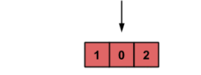
Computing Self-Attention: Example
Attention score: dot product of query with all keys to identify relevant tokens; e.g.,
x = ?
1 | 0 | 2
0
1
1
Key 1:
Value 1:
Key 2:
Value 2:
Key 3:
Value 3:
Query 1:
https://towardsdatascience.com/illustrated-self-attention-2d627e33b20a

Slide 31
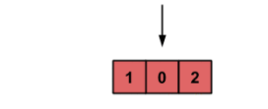
Computing Self-Attention: Example
Attention score: dot product of query with all keys to identify relevant tokens; e.g.,
x = ?
1 | 0 | 2
4
4
0
Key 1:
Value 1:
Key 2:
Value 2:
Key 3:
Value 3:
Query 1:
https://towardsdatascience.com/illustrated-self-attention-2d627e33b20a

Slide 32

Computing Self-Attention: Example
Attention score: dot product of query with all keys to identify relevant tokens; e.g.,
x = ?
1 | 0 | 2
2
3
1
Key 1:
Value 1:
Key 2:
Value 2:
Key 3:
Value 3:
Query 1:
https://towardsdatascience.com/illustrated-self-attention-2d627e33b20a

Slide 33
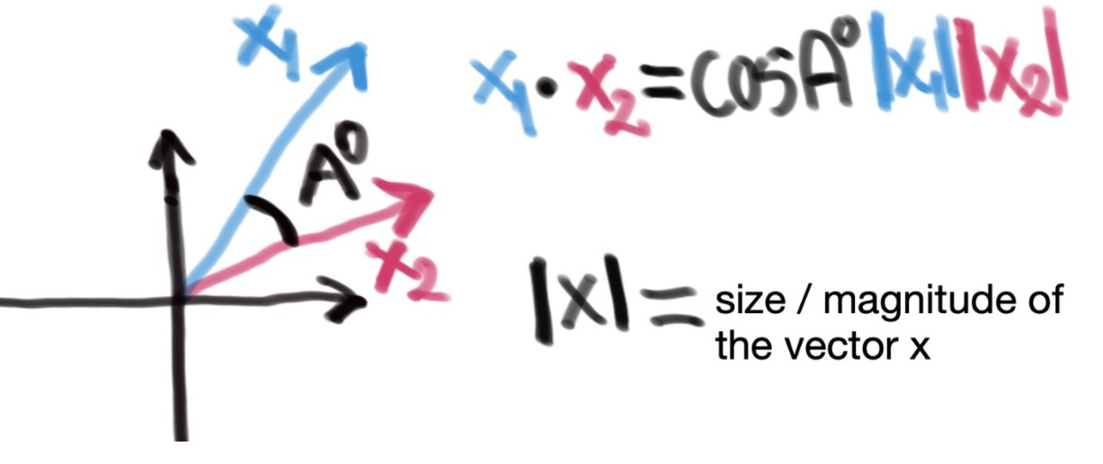
Computing Self-Attention: Example
Why dot product? Indicates similarity of two vectors
Match = 1 (i.e., cos(0))
Opposites = -1 (i.e., cos(180))
Key 1:
Value 1:
Key 2:
Value 2:
Key 3:
Value 3:
https://towardsdatascience.com/
self-attention-5b95ea164f61
Query 1:
https://towardsdatascience.com/illustrated-self-attention-2d627e33b20a

Slide 34
Computing Self-Attention: Example
Can use similarity measures other than the dot product
Key 1:
Value 1:
Key 2:
Value 2:
Key 3:
Value 3:
Query 1:
https://towardsdatascience.com/illustrated-self-attention-2d627e33b20a

Slide 35
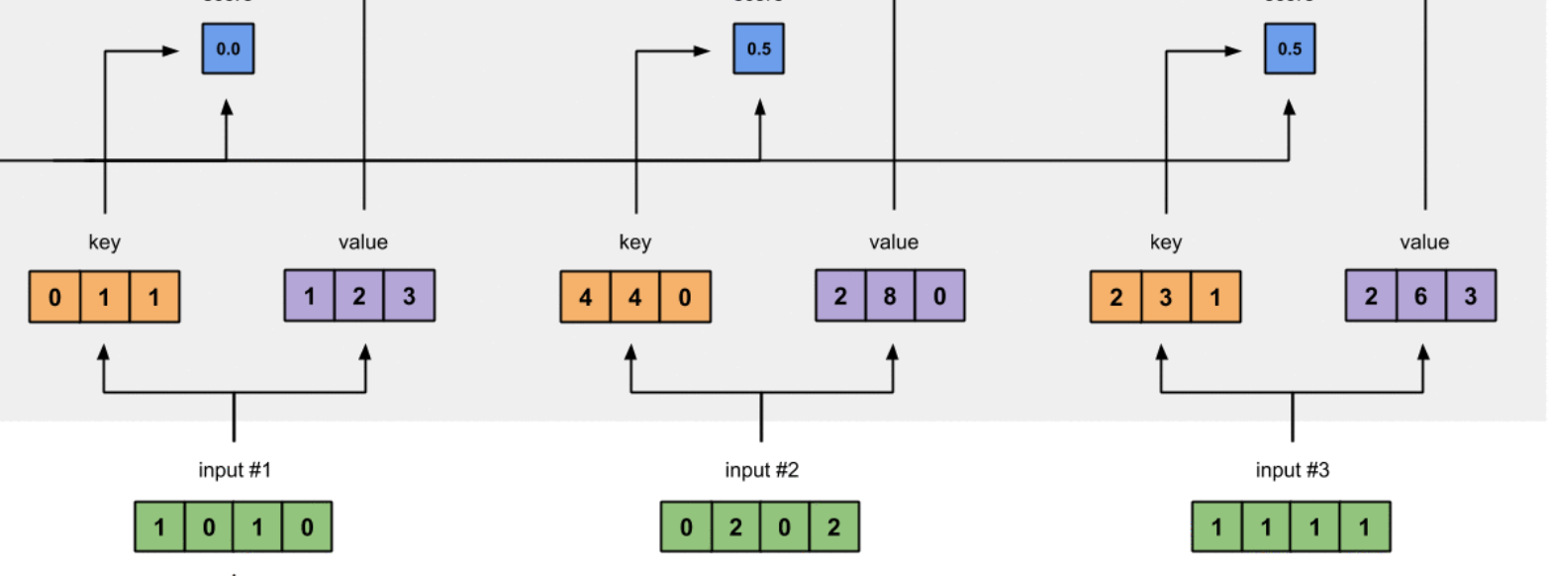

Computing Self-Attention: Example
Attention weights: softmax scores for all inputs to quantify
each token’s relevance; e.g.,
= softmax([2, 4, 4])
0.0 0.5 0.5
= [0.0, 0.5, 0.5])
Note: softmax doesn’t return 0, but can arise from rounding
To which input(s) is input 1
least related?
To which input(s) is input 1
Key 1:
Value 1:
Key 2:
Value 2:
Key 3:
Value 3:
most related?
Query 1:
https://towardsdatascience.com/illustrated-self-attention-2d627e33b20a

Slide 36
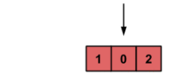
Computing Self-Attention: Example
Compute new representation of input token that reflects entire input:
0.0 0.0 0.0 1.0 4.0 0.0 1.0 3.0 1.5
1. Attention weights x Values
0.0
0.5
0.5
Key 1:
Value 1:
Key 2:
Value 2:
Key 3:
Value 3:
Query 1:
https://towardsdatascience.com/illustrated-self-attention-2d627e33b20a

Slide 37
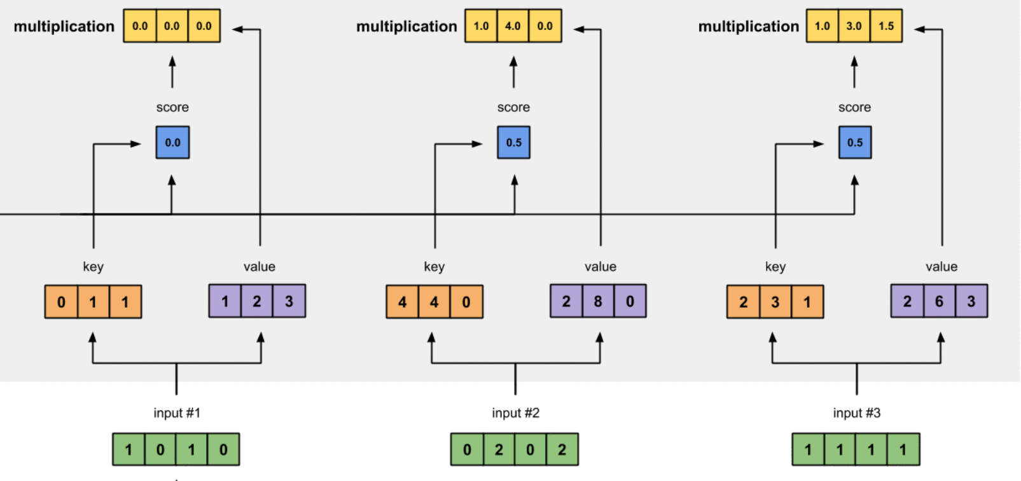
Computing Self-Attention: Example
Compute new representation of input token that reflects entire input:
2.0 | 7.0 | 1.5
0.0
0.0
0.0
1.0
4.0
0.0
1.0
3.0
1.5
1. Attention weights x Values
0.0
0.5
0.5
2. Sum all weighted vectors
Key 1:
Value 1:
Key 2:
Value 2:
Key 3:
Value 3:
Query 1:
https://towardsdatascience.com/illustrated-self-attention-2d627e33b20a

Slide 38
Computing Self-Attention: Example
2.0 | 7.0 | 1.5
0.0
0.0
0.0
1.0
4.0
0.0
1.0
3.0
1.5
Attention weights amplify input representations (values) that we want to pay attention to and repress the rest
0.0
0.5
0.5
Key 1:
Value 1:
Key 2:
Value 2:
Key 3:
Value 3:
Query 1:
https://towardsdatascience.com/illustrated-self-attention-2d627e33b20a

Slide 39
Computing Self-Attention: Example
2.0 | 7.0 | 1.5
0.0
0.0
0.0
1.0
4.0
0.0
1.0
3.0
1.5
Attention weights amplify input representations (values) that we want to pay attention to and repress the rest
0.0
0.5
0.5
Key 1:
Value 1:
Key 2:
Value 2:
Key 3:
Value 3:
Query 1:
https://towardsdatascience.com/illustrated-self-attention-2d627e33b20a

Slide 40
Computing Self-Attention: Example
Repeat the same process for each remaining input token
Key 1:
Value 1:
Key 2:
Value 2:
Key 3:
Value 3:
Query 1:
Query 2:
Query 3:
https://towardsdatascience.com/illustrated-self-attention-2d627e33b20a

Slide 41
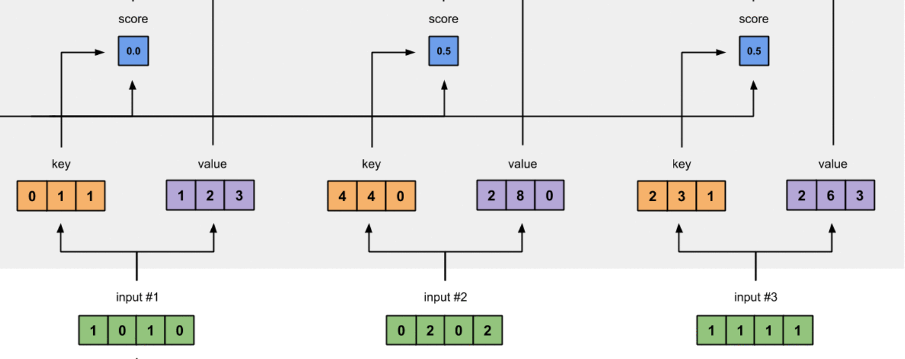
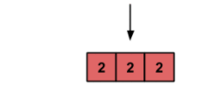
Computing Self-Attention: Example
0.0 1.0 0.0
1. Compute attention weights
- Softmax resulting 3 scores from query x keys
Key 1:
Value 1:
Key 2:
Value 2:
Key 3:
Value 3:
To which input(s) is input 2
most related?
Query 2:
https://towardsdatascience.com/illustrated-self-attention-2d627e33b20a

Slide 42
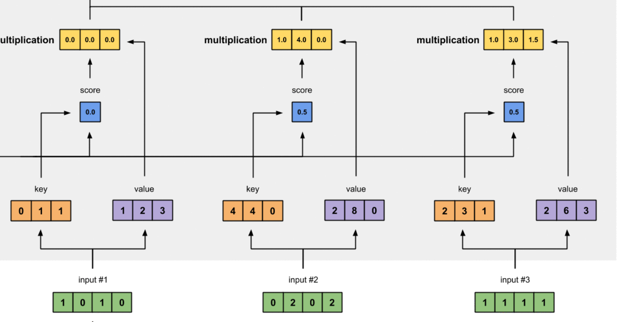
Computing Self-Attention: Example
2.0 8.0 0.0
0.0 0.0 0.0 2.0 8.0 0.0 0.0 0.0 0.0
0.0
1.0
0.0
1. Compute attention weights
- Softmax resulting 3 scores from query x keys
Key 1:
Value 1:
Key 2:
Value 2:
Key 3:
Value 3:
2. Compute weighted sum of
values using attention scores
Query 2:
https://towardsdatascience.com/illustrated-self-attention-2d627e33b20a

Slide 43
Computing Self-Attention: Example
Repeat the same process for each remaining input token
Key 1:
Value 1:
Key 2:
Value 2:
Key 3:
Value 3:
Query 1:
Query 2:
Query 3:
https://towardsdatascience.com/illustrated-self-attention-2d627e33b20a

Slide 44
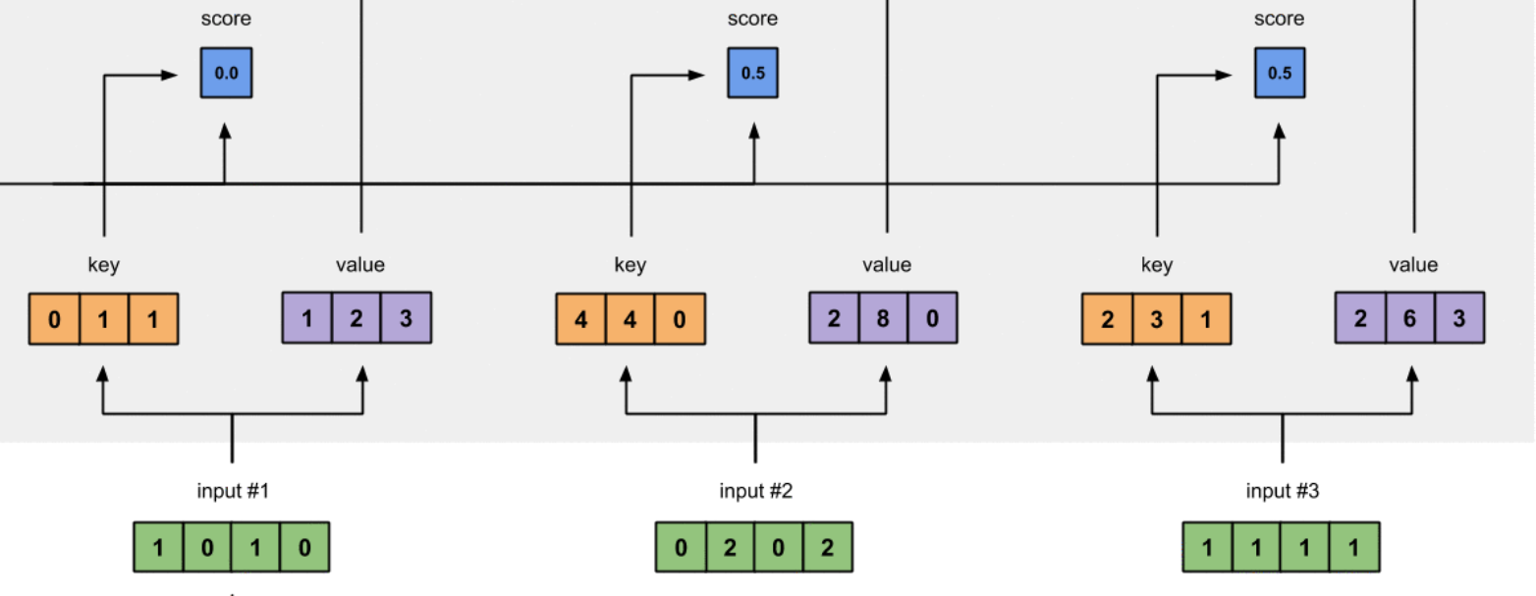
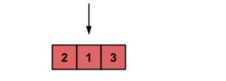
Computing Self-Attention: Example
0.0 0.9 0.1
1. Compute attention weights
- Softmax resulting 3 scores from query x keys
Key 1:
Value 1:
Key 2:
Value 2:
Key 3:
Value 3:
To which input(s) is input 3
most related?
Query 3:
https://towardsdatascience.com/illustrated-self-attention-2d627e33b20a

Slide 45
Computing Self-Attention: Example
2.0 7.8 0.3
0.0 0.0 0.0 1.8 7.2 0.0 0.2 0.6 0.3
0.0
0.9
0.1
1. Compute attention weights
- Softmax resulting 3 scores from query x keys
Key 1:
Value 1:
Key 2:
Value 2:
Key 3:
Value 3:
2. Compute weighted sum of
values using attention scores
Query 2:
https://towardsdatascience.com/illustrated-self-attention-2d627e33b20a

Slide 46
Computing Self-Attention: Example
2.0 | 7.0 | 1.0
2.0 | 8.0 | 0.0
2.0 | 7.8 | 0.3
Key 1:
Value 1:
Key 2:
Value 2:
Key 3:
Value 3:
Query 1:
Query 2:
Query 3:
https://towardsdatascience.com/illustrated-self-attention-2d627e33b20a

Slide 47
Problem: Self-Attention’s Computational Expense
e.g., instead of using 3x3 image, what if a 1920 x 1080 image was used? How many self- attention computations would be needed?
- (1920 x 1080) ² = 4,299,816,960,000 (i.e., ~4.3 trillion)
Quadratic cost of self-attention in transformers is often impractical for pixels!

Slide 48
ViT Solution: Input Patches Instead of Pixels
Assuming a 160 x 160 pixel image, how many patches (and so inputs) would be extracted?
- 10
Image decomposed into 16x16 non- overlapping patches (example simplified); representations include “flattened” and ResNet features
Dosovitskiy et al. An Image is Worth 16x16 Words: Transformers for Image Recognition at Scale. ICLR 2021.

Slide 49
ViT Solution: Use [CLS] for Image Classification
[CLS] token represents entire image
Dosovitskiy et al. An Image is Worth 16x16 Words: Transformers for Image Recognition at Scale. ICLR 2021.

Slide 50
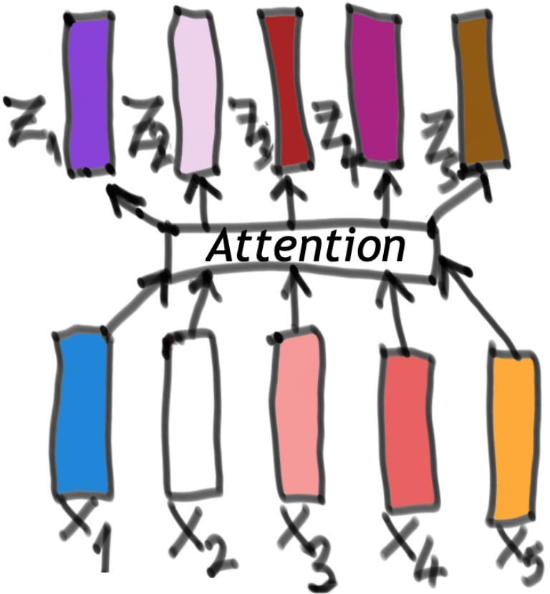
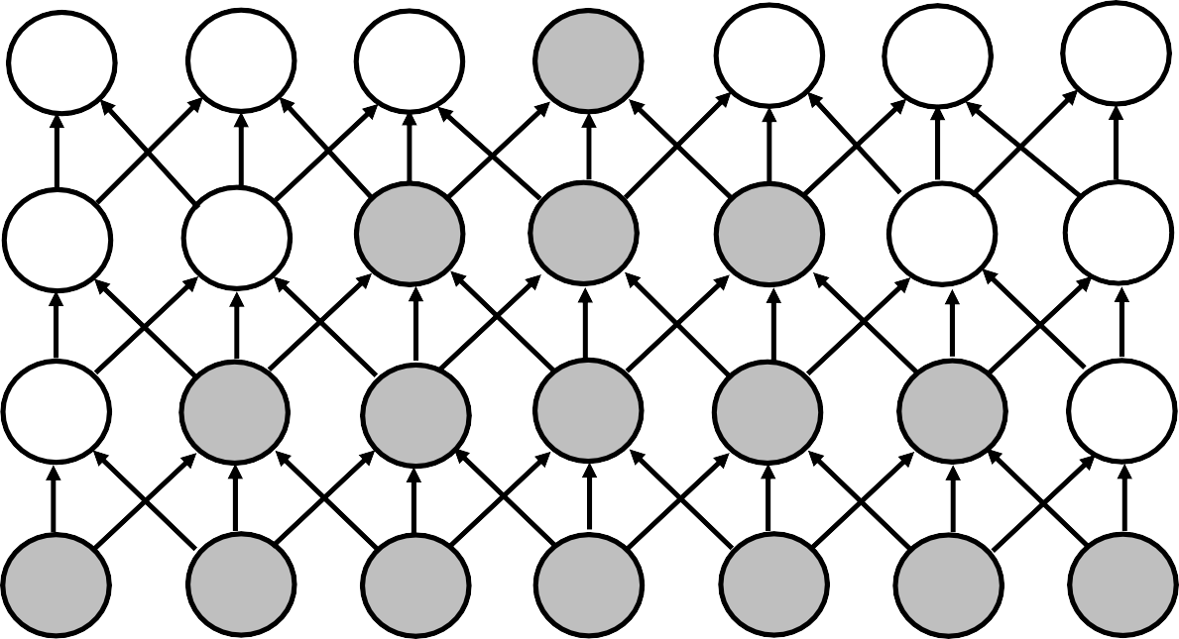
Transformers vs CNNs
Self-attention: each layer has a global receptive field
Convolutional layers: deeper layers have increasingly more global receptive fields
https://towardsdatascience.com
/self-attention-5b95ea164f61
https://www.deeplearningbook. org/contents/convnets.html

Slide 51
ViT: Key Ingredients for Success
Transformer architecture (embeds self-attention)
Pre-training with massive amounts of data

Slide 52
Approach
Inference
https://docs.graphcore.ai/projects/bert-training/en/latest/bert.html

Slide 53
ViT Pre-Training
Dataset: JFT with 303M labeled images (proprietary Google dataset)
Task: classification loss (supervised)
Optimizer: Adam
* Note: research also is exploring how smaller training datasets can be effective; e.g., data efficient image transformers (DeiT) from “Training data-efficient image transformers & distillation through attention”
Dosovitskiy et al. An Image is Worth 16x16 Words: Transformers for Image Recognition at Scale. ICLR 2021.

Slide 54
ViT Training
Inference
https://docs.graphcore.ai/projects/bert-training/en/latest/bert.html

Slide 55
ViT Fine-Tuning: Other Image Classification Tasks
MLP replaced with a single linear layer when fine-tuning to new classification categories
Dosovitskiy et al. An Image is Worth 16x16 Words: Transformers for Image Recognition at Scale. ICLR 2021.

Slide 56
Experimental Findings and Closing Question
ViT achieved strong results on all tested image classification datasets, prompting the question of whether transformers’ success would generalize to other vision tasks.
Dosovitskiy et al. An Image is Worth 16x16 Words: Transformers for Image Recognition at Scale. ICLR 2021.

Slide 57
Image Classification: Outperformed ViT
Inference
Used ImageNet-22K dataset (14.2M images and 22K classes)
Used ImageNet-1K dataset
https://docs.graphcore.ai/projects/bert-training/en/latest/bert.html

